Slide 1

STATS 432 Computational Statistics
Chapter 6 – Permutation Testing (Part I)

Slide 2

6.1 – The Power of a Test

Slide 3



6.1 – The Power of a Test:
6.1 – The Power of a Test
In a hypothesis test we test a null hypothesis H₀ against an alternative hypothesis H₁. There are two types of error that it is possible to make.
 |  | What We Conclude
 |  | H₀ | H₁
What is True | H₀ | No Error | Type I Error
 | H₁ | Type II Error | No Error
$$P\left(Type I Error\right) = P\left(Reject H_{0} | H_{0} is true\right) = α$$
$$P\left(Type II Error\right) = P\left(Accept H_{0} | H_{0} is false\right) = β$$
The power of a test is defined as:
$$Power=1 −β$$
$$=1−P\left(Accept H_{0} | H_{0} is false\right)$$
$$=P\left(Reject H_{0} | H_{0} is false\right)$$
$$=P\left(Accept H_{1} | H_{1} is true\right)$$
3
The greater the power of a test, the better that test is.

Slide 4
6.2 – Motivating Example

Slide 5
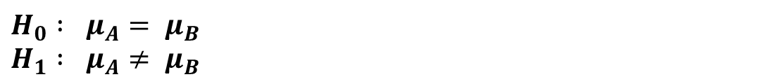


6.2a – Motivating Example:
6.2 – Motivating Example
Consider the following data set which specifies the length (in cm) of a particular species of fish inside (A) and outside (B) of a marine reserve.
A | 49 | 43 | 31 | 44 | 34 | 35 | 47 | 52 | 40 | 53
B | 73 | 68 | 64 | 70 | 46 | 68 | 65 | 32 | 33 | 39
${\overline{y}}_{A}=$ 42.8
${\overline{y}}_{B}=$ 55.8
We are interested in whether the mean length of the fish differs between the two groups,
i.e. we wish to test between the hypotheses:
$$H_{0} : μ_{A}= μ_{B} \\ H_{1} : μ_{A}≠ μ_{B}$$
How may we attack this problem?
5
Associated code = 6.2 – Motivating Example.

Slide 6
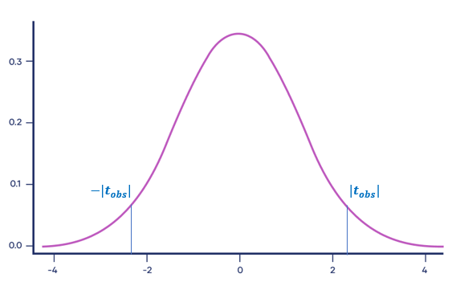

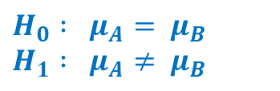
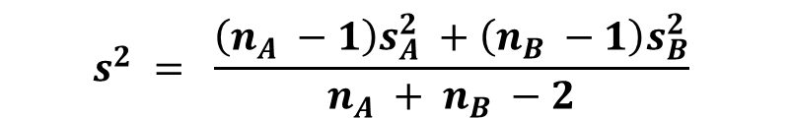
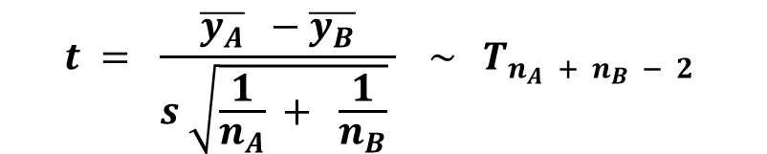
6.2b – T-test (Parametric):
6.2 – Motivating Example
If the data are drawn from two independent, normally distributed populations with equal variance then the test statistic:
$$t = \frac{\overline{y_{A}} −\overline{y_{B}}}{s \sqrt{\frac{1}{n_{A}} + \frac{1}{n_{B}}} } \sim T_{n_{A} + n_{B} − 2}$$
$$s^{2} = \frac{\left(n_{A} −1\right)s_{A}^{2} +\left(n_{B} −1\right)s_{B}^{2}}{n_{A} + n_{B} −2}$$
where
We calculate t_{obs} and look at where this lies in terms of the $T_{n_{A}+ n_{B} − 2}$ distribution.
If the p-value of the test is less than α, then we would reject the null hypothesis at the α% level.
$$H_{0} : μ_{A}= μ_{B} \\ H_{1} : μ_{A}≠ μ_{B}$$
$$p−value= 2 P\left( t≥ \right|t_{obs}| )$$
The p-value of this t-test is equal to 0.03549.
This provides some evidence against the null hypothesis.
However, are the assumptions of the t-test (i.e. independence, normal distributions & equal variance) satisfied?
6
Associated code = 6.2 – Motivating Example.

Slide 7
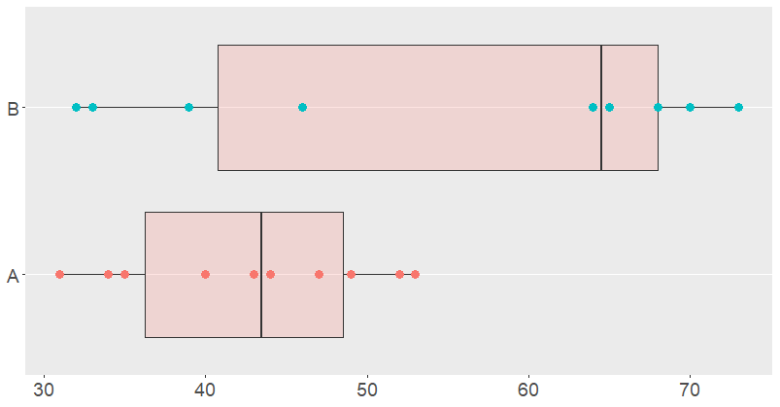
6.2b – T-test (Parametric):
6.2 – Motivating Example
Box-plots of Fish Length in Group A and Group B
Asymmetry:
Suggests underlying populations are not normally distributed.
Range & IQR:
The differing range and IQR of the data suggests that the underlying populations do not have equal variance.
Assumptions of T-test likely to be violated. If so, test statistic does not follow a T-distribution.
We must regard the p-value produced with extreme caution.
7
Associated code = 6.2 – Motivating Example.

Slide 8
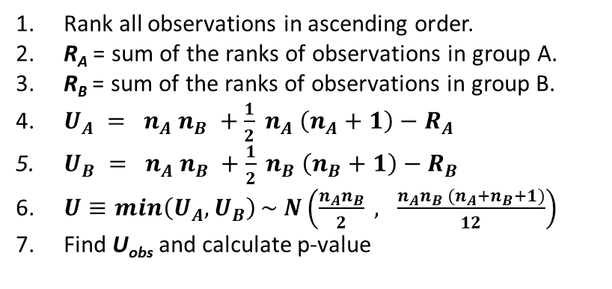
6.2c – Mann-Whitney U-Test (Non-parametric):
6.2 – Motivating Example
The Mann-Whitney U-test (a special case of the Kruskal-Wallis test) is a non-parametric test of the hypotheses:
H₀: The data are drawn from populations with the same distribution H₁: The data are drawn from populations with different distributions
The general idea of the MW U-test is that if the data are drawn from two populations with the same distribution,
then the ranks of the data will be equally dispersed amongst the two groups
General Process:
Rank all observations in ascending order.
R_{A} = sum of the ranks of observations in group A.
R_{B} = sum of the ranks of observations in group B.
$U_{A} = n_{A} n_{B} +\frac{1}{2} n_{A} \left(n_{A}+1\right)−R_{A}$
$U_{B} = n_{A} n_{B} +\frac{1}{2} n_{B} \left(n_{B}+1\right)−R_{B}$
$U≡\min\left(U_{A}, U_{B}\right)\sim N\left(\frac{n_{A}n_{B}}{2} , \frac{n_{A}n_{B} (n_{A}+n_{B}+1)}{12}\right)$
Find U_{obs} and calculate p-value
The p-value of the MW U-test is 0.1123.
This is much larger than the p-value for the corresponding t-test.
Non-parametric tests make fewer assumptions (and are therefore more likely to be valid) but tend to have much less power than parametric counterparts.
8
Associated code = 6.2 – Motivating Example.

Slide 9
6.2d – Conclusion:
6.2 – Motivating Example
Ultimately, we want a test that makes as few assumptions as a non-parametric test but whose power is similar to that of a parametric test.
9

Slide 10
6.3 – Basic Idea of Permutation Tests

Slide 11
6.3a – The Basic Idea of Permutation Tests:
6.3a – Basic Idea
Permutation tests are a method of testing whether a particular property (e.g. the mean) is constant amongst k population groups (H₀), or whether this property differs between at least two of them (H₁). The general premise is as follows:
We have a test statistic F which measures whether the property of interest is the same across all groups or not. We calculate the value of this test statistic for our initial sample and call this F_{obs}.
If the property of interest is the same across all groups (H₀ is true), then the data are exchangeable, i.e. randomly switching observations of the response variable between groups should not have too much of an effect on the value of test statistic.
In which case, F_{obs} is likely to be just a typical value from the distribution of test statistics produced from our re-ordered samples.
If the property of interest is different across groups (H₁ is true), then the data are not exchangeable, i.e. randomly switching observations of the response variable between groups is likely to have a big effect on the test statistic.
In which case, F_{obs} is likely to be an extremal value from the distribution of test statistics produced from our re-ordered samples.
Thus, we calculate F_{obs} and see where it lies in the distribution of test statistics produced from our re-ordered samples. Based on this information we decide whether to accept or reject the null hypothesis.
11

Slide 12
6.3a – The Basic Idea of Permutation Tests:
6.3a – Basic Idea
Permutation tests typically progress according to the following steps…
Step 1:
We are interested in whether some property is constant across k population groups or whether this property differs between at least two of them. We assume that no suitable parametric test exists.
Step 2:
We consider the hypotheses:
H₀: The property is constant across all groups
H₁: The property differs amongst at least two of the groups
Since permutation tests are non-parametric, H₀ and H₁ often cannot be written in terms of a parameter distribution. They tend to be more general statements compared to when conducting parametric tests.
Step 3:
We take a sample of size n containing…
k₁ observations in the first group,
k₂ observations in the observations from the second group,
…..
k_{k} observations from the k^{th} group.
We then calculate the value of an appropriate test statistic F_{obs} which measures whether the property is constant across each of the groups.
12

Slide 13
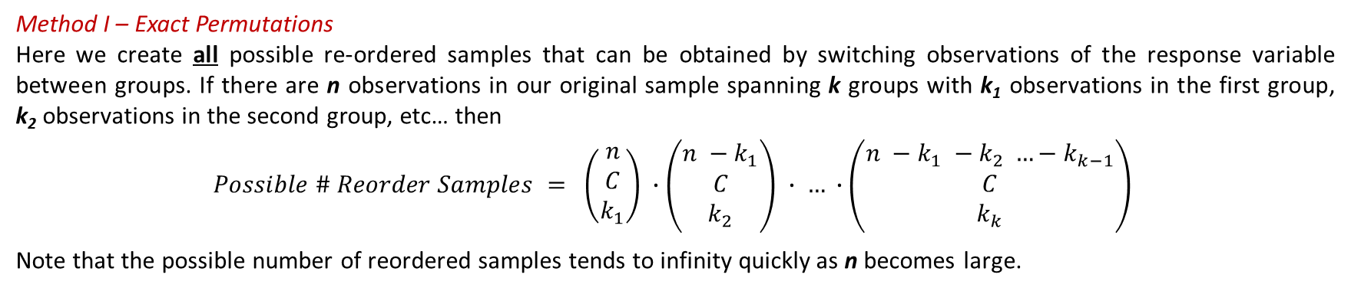
6.3a – The Basic Idea of Permutation Tests:
6.3a – Basic Idea
Step 4:
We then create multiple re-ordered samples of the data by one of two methods.
Method I – Exact Permutations
Here we create all possible re-ordered samples that can be obtained by switching observations of the response variable between groups. If there are n observations in our original sample spanning k groups with k₁ observations in the first group, k₂ observations in the second group, etc… then
$$Possible \# Reorder Samples = \left(\begin{matrix}n \\ C \\ k_{1}\end{matrix}\right) ∙\left(\begin{matrix}n −k_{1} \\ C \\ k_{2}\end{matrix}\right) ∙ … ∙\left(\begin{matrix}n −k_{1} −k_{2} …−k_{k−1} \\ C \\ k_{k}\end{matrix}\right)$$
Note that the possible number of reordered samples tends to infinity quickly as n becomes large.
Method II – Random Permutations
Since it is often not computationally practical to create all possible reordered samples, we simply create a large number i = 1, … , L (≈1,000) reordered samples
13

Slide 14
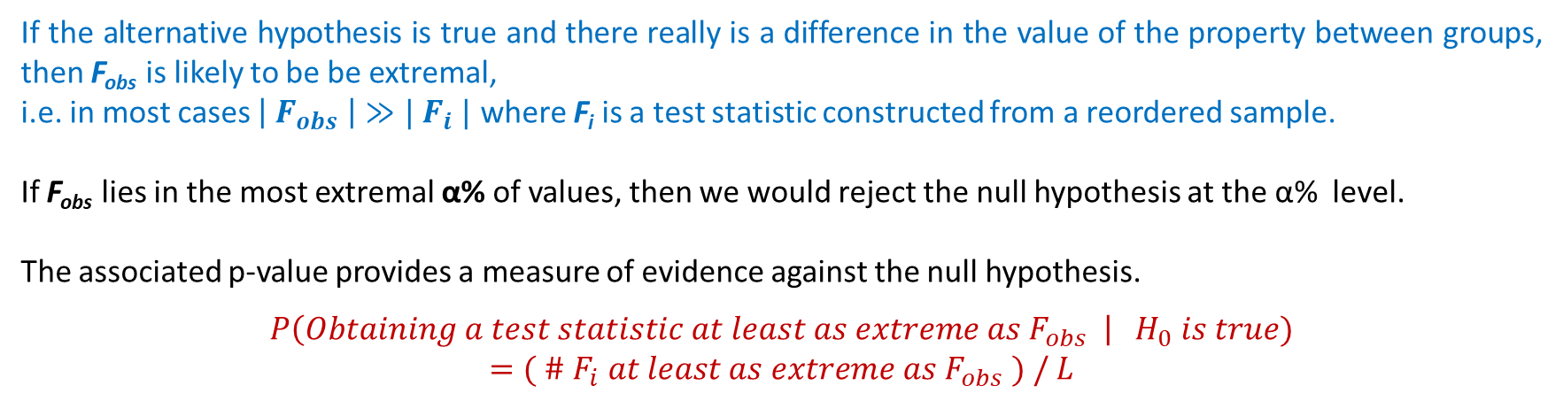
6.3a – The Basic Idea of Permutation Tests:
6.3a – Basic Idea
Step 5:
For each reordered sample from i = 1, … , L we calculate the value of the test statistic F_{i} .
The empirical distribution of the ${\left\{F_{i}\right\}}_{i=1}^{L}$ approximates the distribution of the test statistic that can occur under H₀
Step 6:
Finally, we rank the test statistics from lowest to highest and see where F_{obs} lies within this distribution.
If the alternative hypothesis is true and there really is a difference in the value of the property between groups, then F_{obs} is likely to be be extremal,
i.e. in most cases $\left| F_{obs} \right|≫| F_{i} |$ where F_{i} is a test statistic constructed from a reordered sample.
If F_{obs} lies in the most extremal α% of values, then we would reject the null hypothesis at the α% level.
The associated p-value provides a measure of evidence against the null hypothesis.
$$P\left(Obtaining a test statistic at least as extreme as F_{obs} \right|{ H}_{0} is true)$$
$$=( \# F_{i} at least as extreme as F_{obs} ) / L$$
Note:
If we use the method of Exact Permutations in Step 4 we will get an ‘exact’ p-value.
If we use the method of Random Permutations in Step 4 we will get an estimate of the ‘true’ p-value.
14

Slide 15
6.3a – The Basic Idea of Permutation Tests:
6.3a – Basic Idea
Permutation tests are particularly useful when:
The conditions of parametric tests are violated, or no suitable parametric tests exist
Sample sizes are too small to determine whether the conditions of a parametric test are satisfied.
Data is sampled from an unknown distribution
Outliers are present in the data
Warnings:
Permutation testing is not a silver bullet. If the original sample is a poor representation of the population, then the inferences gathered from permutation testing can be misleading.
Whereas with parametric tests it is possible to go on to make estimates / construct confidence intervals for the property under consideration for each group, this is not always possible with permutation tests. Often the only conclusion we can draw is that the property in question differs across the groups.
15

Slide 16
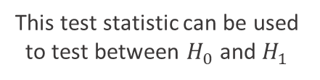
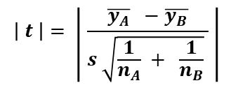


6.3b – Application to Motivating Example:
6.3b – Motivating Example
To make these ideas concrete let’s apply them to our motivating example
Consider the following data set which specifies the length (in cm) of a particular species of fish inside (A) and outside (B) of a marine reserve.
A | 49 | 43 | 31 | 44 | 34 | 35 | 47 | 52 | 40 | 53
B | 73 | 68 | 64 | 70 | 46 | 68 | 65 | 32 | 33 | 39
${\overline{y}}_{A}=$ 42.8
${\overline{y}}_{B}=$ 55.8
We are interested in whether the mean length of the fish differs between the two groups,
i.e. we wish to test between the hypotheses:
$H_{0} :$ No difference in mean length of fish inside (A) & outside (B) reserve $H_{1} :$ Mean length of fish differs inside (A) & outside (B) reserve
Two-sided test
$$\left| t \right|= \left| \frac{\overline{y_{A}} −\overline{y_{B}}}{s \sqrt{\frac{1}{n_{A}} + \frac{1}{n_{B}}} } \right|$$
This test statistic can be used to test between $H_{0}$ and $H_{1}$
16
Associated code = 6.3 - Application of Permutation Testing to Motivating Example.

Slide 17

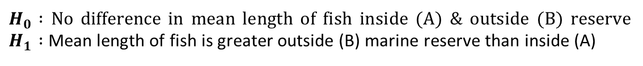



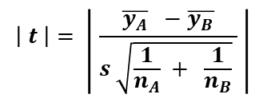

6.3b – Application to Motivating Example:
6.3b – Motivating Example
Step 1&2:
Does the mean length of a particular species of fish differ inside (A) and outside (B) a marine reserve.
$H_{0} :$ No difference in mean length of fish inside (A) & outside (B) reserve $H_{1} :$ Mean length of fish is greater outside (B) marine reserve than inside (A)
Two-sided test
Step 3:
Take a sample of data and determine an appropriate test statistic, in this case the t-statistic.
A | 49 | 43 | 31 | 44 | 34 | 35 | 47 | 52 | 40 | 53
B | 73 | 68 | 64 | 70 | 46 | 68 | 65 | 32 | 33 | 39
$$\left| t \right|= \left| \frac{\overline{y_{A}} −\overline{y_{B}}}{s \sqrt{\frac{1}{n_{A}} + \frac{1}{n_{B}}} } \right|$$
$${| t}_{obs }| =2.273$$
Step 4&5:
Create 1,000 re-ordered samples by permuting observations between groups.
Obtain the associated distribution of test statistics.
Re-ordered Sample
1
A | 73 | 43 | 31 | 70 | 34 | 68 | 47 | 32 | 40 | 53
B | 49 | 68 | 64 | 44 | 46 | 35 | 65 | 52 | 33 | 39
$${| t}_{1}| =0.062$$
$$\begin{matrix}⋮ \\ ⋮\end{matrix}$$
$$\begin{matrix}⋮ \\ ⋮\end{matrix}$$
Re-ordered Sample
1000
A | 73 | 68 | 64 | 44 | 34 | 35 | 65 | 32 | 40 | 39
B | 49 | 43 | 31 | 70 | 46 | 68 | 47 | 52 | 33 | 53
$${| t}_{1,000} | =0.031$$
17
Associated code = 6.3 - Application of Permutation Testing to Motivating Example.

Slide 18
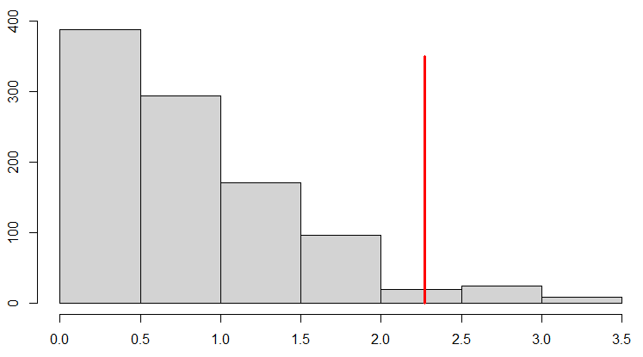
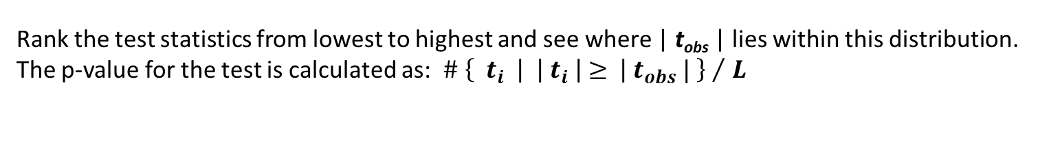
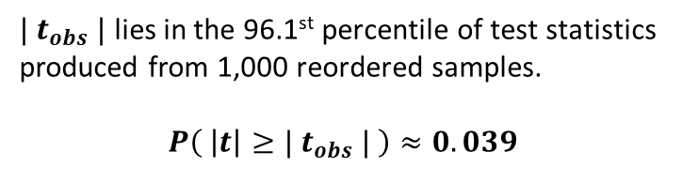

6.3b – Application to Motivating Example:
6.3b – Motivating Example
Step 6:
Rank the test statistics from lowest to highest and see where | t_{obs} | lies within this distribution.
The p-value for the test is calculated as: ${\# \left\{{ t}_{i} \left| \right|{ t}_{i} \left| ≥ \right| t_{obs} | \right\} }/{ L}$
Histogram of Test Statistics Produced from 1,000 Reordered Samples
$| t_{obs} |$ lies in the 96.1st percentile of test statistics produced from 1,000 reordered samples.
$$P\left( \left|t\right|≥{| t}_{obs} | \right)≈0.039$$
$$| t_{obs }| =2.273$$
Permutation test yields some evidence against null hypothesis that mean length of fish is the same inside (A) and outside (B) of the marine reserve.
Conclude that there is a difference in the mean length of fish inside and outside the reserve.
18
Associated code = 6.3 - Application of Permutation Testing to Motivating Example.

Slide 19

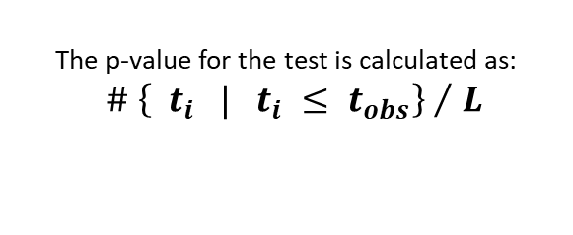
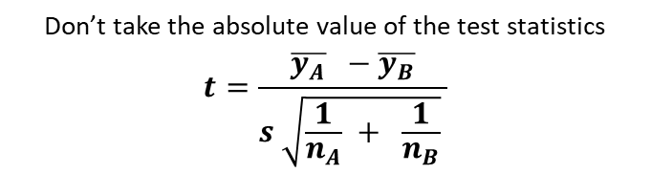

6.3b – Application to Motivating Example:
6.3b – Motivating Example
What if we had wanted to make this a one-sided test?
Consider the following data set which specifies the length (in cm) of a particular species of fish inside (A) and outside (B) of a marine reserve.
A | 49 | 43 | 31 | 44 | 34 | 35 | 47 | 52 | 40 | 53
B | 73 | 68 | 64 | 70 | 46 | 68 | 65 | 32 | 33 | 39
${\overline{y}}_{A}=$ 42.8
${\overline{y}}_{B}=$ 55.8
We are interested in whether the mean length of the fish differs between the two groups,
i.e. we wish to test between the hypotheses:
$H_{0} :$ No difference in mean length of fish inside (A) & outside (B) reserve $H_{1} :$ Mean length of fish is greater outside (B) marine reserve than inside (A)
One-sided test
Do the same thing but…
Don’t take the absolute value of the test statistics
$$t=\frac{\overline{y_{A}} −\overline{y_{B}}}{s \sqrt{\frac{1}{n_{A}} + \frac{1}{n_{B}}} }$$
The p-value for the test is calculated as:
${\# \left\{{ t}_{i} | t_{i} ≤ t_{obs}\right\} }/{ L}$
19
Associated code = 6.3 - Application of Permutation Testing to Motivating Example.

Slide 20
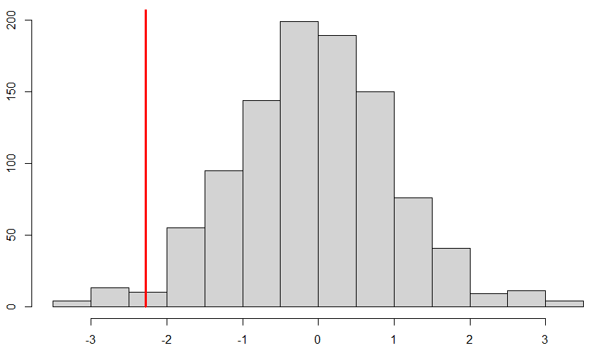
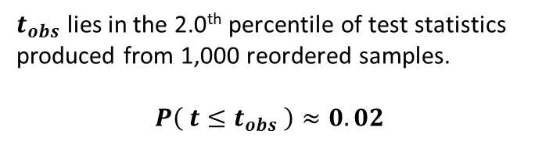

6.3b – Application to Motivating Example:
6.3b – Motivating Example
Histogram of Test Statistics Produced from 1,000 Reordered Samples
$$t_{obs } =− 2.273$$
$t_{obs}$ lies in the 2.0th percentile of test statistics produced from 1,000 reordered samples.
$$P\left( t≤t_{obs} \right)≈0.02$$
Permutation test yields some evidence against null hypothesis that mean length of fish is the same inside (A) and outside (B) of the marine reserve.
We would conclude fish size is greater outside reserve
20
Associated code = 6.3 - Application of Permutation Testing to Motivating Example.

Slide 21
6.4 – The Choice of Test Statistic

Slide 22
6.4a – The Choice of Test Statistic
6.4 – Choice of Test Statistic
A suitable test statistic for a permutation test is any statistic that will reflect differences in the property under consideration between groups, as this will provide evidence against the null hypothesis.
Two test statistics, F₁ and F₂, are said to be equivalent if their application to the collection of all possible re-ordered samples will endow them with the same ordering:
i.e. applying test statistic F₁ to every possible re-ordered sample and ranking them in ascending order of the value of F₁
would give exactly the same ordering if we were to repeat the process with test statistic F₂
22

Slide 23


6.4a – The Choice of Test Statistic
6.4 – Choice of Test Statistic
Consider the test statistics $F_{1}$ and $F_{2}$. Suppose we have 1,000 reordered samples $S_{1}, S_{2}, …, S_{1000}$
If $F_{1}$ and $F_{2}$ are equivalent, then if $F_{1}$ ranks the samples in the following way…
$$F_{1}\left(S_{17}\right) < F_{1}\left(S_{23}\right)< F_{1}\left(S_{852}\right)< F_{1}\left(S_{206}\right) < …< F_{1}\left(S_{907}\right)< F_{1}\left(S_{761}\right)$$
$$F_{1, Obs}$$
then if $F_{2}$ will also rank the samples in the same way…
$$F_{2, Obs}$$
$$F_{2}\left(S_{17}\right) < F_{2}\left(S_{23}\right)< F_{2}\left(S_{852}\right)< F_{2}\left(S_{206}\right) < …< F_{2}\left(S_{907}\right)< F_{2}\left(S_{761}\right)$$
$F_{1, Obs}$ and $F_{2, Obs}$ will therefore fall in the same position in the distribution of test statistics…
… and so always yield the same p-value for a permutation test.
23

Slide 24
6.4a – The Choice of Test Statistic
6.4 – Choice of Test Statistic
A suitable test statistic for a permutation test is any statistic that will reflect differences in the property under consideration between groups, as this will provide evidence against the null hypothesis.
Two test statistics, F₁ and F₂, are said to be equivalent if their application to the collection of all possible re-ordered samples will endow them with the same ordering:
i.e. applying test statistic F₁ to every possible re-ordered sample and ranking them in ascending order of the value of F₁
would give exactly the same ordering if we were to repeat the process with test statistic F₂
If two test statistics are equivalent, they rank all reordered samples in the same order and so yield the same p-value for a permutation test.
However, in general most test statistics are not equivalent.
24

Slide 25
6.4a – The Choice of Test Statistic
6.4 – Choice of Test Statistic
The choice of which test statistic to use within a permutation test is important because:
The choice of test statistic can affect the power of the test.
The choice of test statistic affects the speed of the algorithm
In a permutation test we have to run many (≈1,000) iterations.
A test statistic which is easier to calculate will reduce computation time.
If faced with the option of two equivalent test statistics, always choose the one that is
computationally simpler.
25

Slide 26

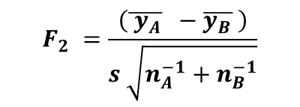

6.4a – The Choice of Test Statistic
6.4 – Choice of Test Statistic
Consider the following data set and the three test statistics F₁, F₂ and F₃.
$$F_{2} =\frac{\left(\overline{ y_{A}} −\overline{y_{B}} \right)}{s \sqrt{n_{A}^{−1}+n_{B}^{−1}}}$$
Group A | 16 | 20
Group B | 6 | 11 | 18
$$F_{1}=\overline{ y_{A}} −\overline{y_{B}}$$
$$F_{3}=Med_{A} −Med_{B}$$
There are (⁵C₂) * (³C₃) = 10 re-ordered samples it is possible to make with this data set. They are shown below:
Group A | 16 | 16 | 16 | 16 | 20 | 20 | 20 | 6 | 6 | 11
Group A | 20 | 6 | 11 | 18 | 6 | 11 | 18 | 11 | 18 | 18
Group B | 6 | 20 | 20 | 20 | 16 | 16 | 16 | 16 | 16 | 16
Group B | 11 | 11 | 6 | 6 | 11 | 6 | 6 | 20 | 20 | 20
Group B | 18 | 18 | 18 | 11 | 18 | 18 | 11 | 18 | 11 | 6
F₁ | 6.33 | -5.33 | -1.17 | 4.67 | -2.00 | 2.17 | 8.00 | -9.50 | -3.67 | 0.50
F₂ | 1.34 | -1.04 | -0.20 | 0.87 | -0.34 | 0.37 | 2.10 | -3.98 | -0.66 | 0.08
F₃ | 7.00 | -7.00 | -4.50 | 6.00 | -3.00 | -0.50 | 8.00 | -9.50 | -4.00 | -1.50
F₁ Rank | 2 | 9 | 6 | 3 | 7 | 4 | 1 | 10 | 8 | 5
F₂ Rank | 2 | 9 | 6 | 3 | 7 | 4 | 1 | 10 | 8 | 5
F₃ Rank | 2 | 9 | 8 | 3 | 6 | 4 | 1 | 10 | 7 | 5
26

Slide 27
6.4a – The Choice of Test Statistic
6.4 – Choice of Test Statistic
Consider the following data set and the three test statistics F₁, F₂ and F₃.
$$F_{2} =\frac{\left(\overline{ y_{A}} −\overline{y_{B}} \right)}{s \sqrt{n_{A}^{−1}+n_{B}^{−1}}}$$
Group A | 16 | 20
Group B | 6 | 11 | 18
$$F_{1}=\overline{ y_{A}} −\overline{y_{B}}$$
$$F_{3}=Med_{A} −Med_{B}$$
There are (⁵C₂) * (³C₃) = 10 re-ordered samples it is possible to make with this data set. They are shown below:
Group A | 16 | 16 | 16 | 16 | 20 | 20 | 20 | 6 | 6 | 11
Group A | 20 | 6 | 11 | 18 | 6 | 11 | 18 | 11 | 18 | 18
Group B | 6 | 20 | 20 | 20 | 16 | 16 | 16 | 16 | 16 | 16
Group B | 11 | 11 | 6 | 6 | 11 | 6 | 6 | 20 | 20 | 20
Group B | 18 | 18 | 18 | 11 | 18 | 18 | 11 | 18 | 11 | 6
F₁ | 6.33 | -5.33 | -1.17 | 4.67 | -2.00 | 2.17 | 8.00 | -9.50 | -3.67 | 0.50
F₂ | 1.34 | -1.04 | -0.20 | 0.87 | -0.34 | 0.37 | 2.10 | -3.98 | -0.66 | 0.08
F₃ | 7.00 | -7.00 | -4.50 | 6.00 | -3.00 | -0.50 | 8.00 | -9.50 | -4.00 | -1.50
F₁ Rank | 2 | 9 | 6 | 3 | 7 | 4 | 1 | 10 | 8 | 5
F₂ Rank | 2 | 9 | 6 | 3 | 7 | 4 | 1 | 10 | 8 | 5
F₃ Rank | 2 | 9 | 8 | 3 | 6 | 4 | 1 | 10 | 7 | 5
F₁ and F₂ rank all re-ordered samples in the same way.
It can be shown that these are equivalent test statistics.
F₁ should be preferred to F₂ as it is computationally simpler.
27

Slide 28
6.4a – The Choice of Test Statistic
6.4 – Choice of Test Statistic
Consider the following data set and the three test statistics F₁, F₂ and F₃.
$$F_{2} =\frac{\left(\overline{ y_{A}} −\overline{y_{B}} \right)}{s \sqrt{n_{A}^{−1}+n_{B}^{−1}}}$$
Group A | 16 | 20
Group B | 6 | 11 | 18
$$F_{1}=\overline{ y_{A}} −\overline{y_{B}}$$
$$F_{3}=Med_{A} −Med_{B}$$
There are (⁵C₂) * (³C₃) = 10 re-ordered samples it is possible to make with this data set. They are shown below:
Group A | 16 | 16 | 16 | 16 | 20 | 20 | 20 | 6 | 6 | 11
Group A | 20 | 6 | 11 | 18 | 6 | 11 | 18 | 11 | 18 | 18
Group B | 6 | 20 | 20 | 20 | 16 | 16 | 16 | 16 | 16 | 16
Group B | 11 | 11 | 6 | 6 | 11 | 6 | 6 | 20 | 20 | 20
Group B | 18 | 18 | 18 | 11 | 18 | 18 | 11 | 18 | 11 | 6
F₁ | 6.33 | -5.33 | -1.17 | 4.67 | -2.00 | 2.17 | 8.00 | -9.50 | -3.67 | 0.50
F₂ | 1.34 | -1.04 | -0.20 | 0.87 | -0.34 | 0.37 | 2.10 | -3.98 | -0.66 | 0.08
F₃ | 7.00 | -7.00 | -4.50 | 6.00 | -3.00 | -0.50 | 8.00 | -9.50 | -4.00 | -1.50
F₁ Rank | 2 | 9 | 6 | 3 | 7 | 4 | 1 | 10 | 8 | 5
F₂ Rank | 2 | 9 | 6 | 3 | 7 | 4 | 1 | 10 | 8 | 5
F₃ Rank | 2 | 9 | 8 | 3 | 6 | 4 | 1 | 10 | 7 | 5
F₃ is not equivalent to F₁ and F₂ as it ranks some of the re-ordered samples differently.
The choice of mean vs median should be dictated by the nature of the data. For data with a severe skew (e.g. house prices, income, etc.) the median is often more appropriate.
28

Slide 29
6.5 – Permutation Testing
in One Way ANOVA

Slide 30
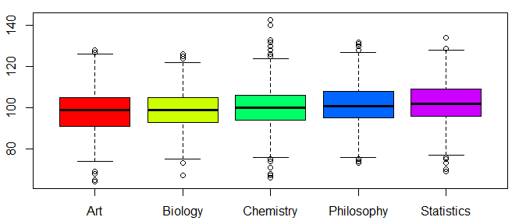
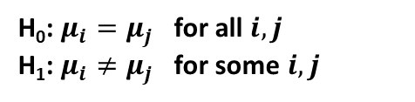
6.5 – Permutation Testing in One Way ANOVA
6.5a – The One-Way ANOVA Model:
In one-way ANOVA we are interested in whether the means of k populations groups are the same,
or whether the means of at least two of the groups differ.
Some researchers are interested in whether the mean IQs of students studying various degrees differ. They take a sample of 1,000 Art, Biology, Chemistry, Philosophy and Statistics students and make them sit an IQ test. A snapshot of the results is shown below.
Student | Art | Biology | Chemistry | Philosophy | Statistics
1 | 110 | 120 | 86 | 95 | 106
2 | 102 | 126 | 71 | 108 | 97
3 | 103 | 104 | 92 | 100 | 104
4 | 96 | 102 | 104 | 118 | 100
5 | 84 | 110 | 89 | 77 | 92
6 | 102 | 105 | 98 | 103 | 101
7 | 116 | 91 | 109 | 85 | 95
8 | 102 | 113 | 95 | 97 | 100
9 | 97 | 96 | 107 | 108 | 107
10 | 108 | 90 | 113 | 99 | 106
11 | 112 | 109 | 97 | 103 | 99
12 | 81 | 103 | 85 | 85 | 104
13 | 101 | 112 | 107 | 106 | 104
14 | 92 | 90 | 104 | 109 | 98
15 | 119 | 112 | 100 | 113 | 83
Do students studying different degrees have different mean IQs?
H₀: $μ_{i}=μ_{j}$ for all $i,j$
H₁: $μ_{i}≠μ_{j}$ for some $i,j$
30

Slide 31
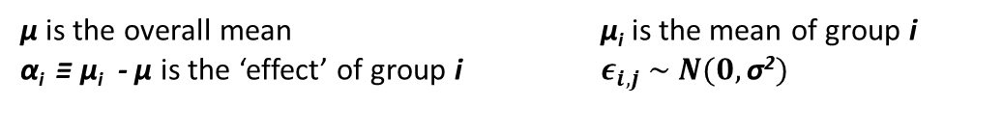

6.5 – Permutation Testing in One Way ANOVA
6.5a – The One-Way ANOVA Model:
Suppose that we have a total of i = 1, …, k population groups that are:
Independent
Normally distributed
Have equal variance σ²
ANOVA Conditions:
We are interested in whether or not the means of these groups are the same.
We model the j^{th} observation in group i as:
$Y_{i,j} = μ + α_{i} + ε_{i,j} ≡ μ_{i} + ε_{i,j}$
$$μ_{i} ≡ {μ + α}_{i}$$
μ is the overall mean μ_{i} is the mean of group i
α_{i} ≡ μ_{i} - μ is the ‘effect’ of group i $ε_{i,j} \sim N(0,\text{σ}\text{2})$
31

Slide 32
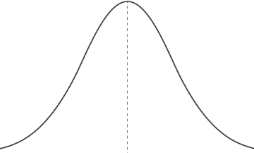












6.5 – Permutation Testing in One Way ANOVA
6.5a – The One-Way ANOVA Model:
$Y_{i,j} = μ + α_{i} + ε_{i,j} ≡ μ_{i} + ε_{i,j}$
$ε_{i,j} \sim N(0,\text{σ}\text{2})$
Consider modelling $Y_{1,j}$
Consider modelling $Y_{2,j}$
$$Y_{2,j}$$
$$α_{2}<0$$
$$α_{1}>0$$
$$Y_{1,j}$$
$$μ+α_{2}$$
$$μ$$
$$μ+α_{1}$$
$$≡$$
$$μ_{2}$$
$$≡$$
$$μ_{1}$$
32

Slide 33

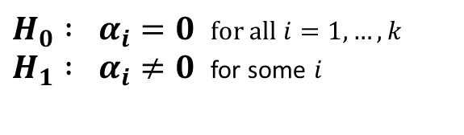
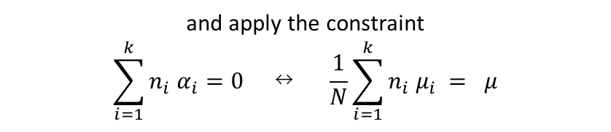

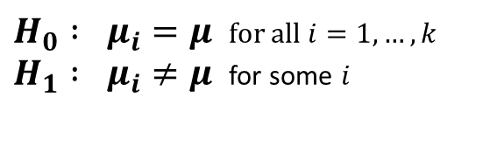
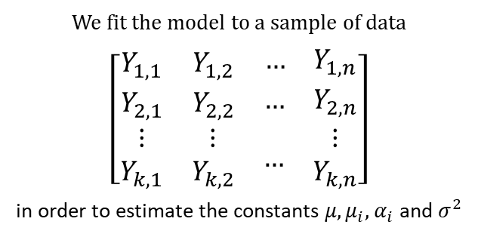
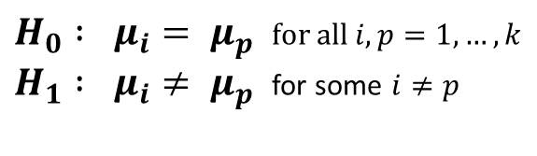

6.5 – Permutation Testing in One Way ANOVA
6.5a – The One-Way ANOVA Model:
Suppose that we have a total of i = 1, …, k population groups that are:
Independent
Normally distributed
Have equal variance σ²
We fit the model to a sample of data
$\left[\begin{matrix}Y_{1,1} & Y_{1,2} & \begin{matrix}… & Y_{1,n}\end{matrix} \\ Y_{2,1} & Y_{2,2} & \begin{matrix}… & Y_{2,n}\end{matrix} \\ \begin{matrix}⋮ \\ Y_{k,1}\end{matrix} & \begin{matrix}⋮ \\ Y_{k,2}\end{matrix} & \begin{matrix}… & \begin{matrix}⋮ \\ Y_{k,n}\end{matrix}\end{matrix}\end{matrix}\right]$
in order to estimate the constants $μ, μ_{i},$ $α_{i}$ and $σ^{2}$
ANOVA Conditions:
We are interested in whether or not the means of these groups are the same.
We model the j^{th} observation in group i as:
$Y_{i,j} = μ + α_{i} + ε_{i,j} ≡ μ_{i} + ε_{i,j}$
$$μ_{i} ≡ {μ + α}_{i}$$
μ is the overall mean μ_{i} is the mean of group i
α_{i} ≡ μ_{i} - μ is the ‘effect’ of group i $ε_{i,j} \sim N(0,\text{σ}\text{2})$
and apply the constraint
$$\sum_{i=1}^{k}{{n_{i} α}_{i}}=0 ↔ \frac{1}{N}\sum_{i=1}^{k}{n_{i} μ_{i}} = μ$$
We want to test the hypothesis that the means of all the groups are equal, i.e.
$H_{0} : μ_{i}= μ_{p}$ for all $i,p=1, …, k$ $H_{1} : μ_{i}≠ μ_{p}$ for some $i≠p$
$H_{0} : μ_{i}=μ$ for all $i=1, …, k$ $H_{1} : μ_{i}≠μ$ for some $i$
$H_{0} : α_{i}=0$ for all $i=1, …, k$ $H_{1} : α_{i}≠0$ for some $i$
$$↔$$
$$↔$$
33

Slide 34
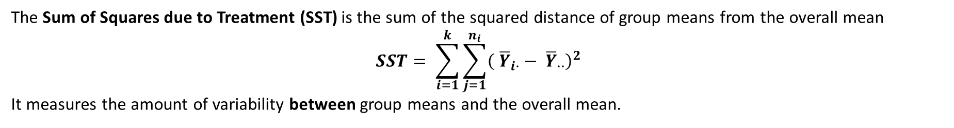


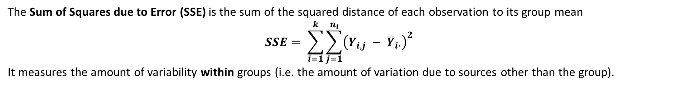
6.5 – Permutation Testing in One Way ANOVA
6.5a – The One-Way ANOVA Model:
The Total Sum of Squares (TSS) is the sum of the squared distance of each observation from the overall mean
$$TSS= \sum_{i=1}^{k}{\sum_{j=1}^{n_{i}}{{\left(Y_{i,j} − {\overline{Y}}_{∙∙}\right)}^{2}}}$$
$\left[\begin{matrix}Y_{1,1} & Y_{1,2} & \begin{matrix}… & Y_{1,n}\end{matrix} \\ Y_{2,1} & Y_{2,2} & \begin{matrix}… & Y_{2,n}\end{matrix} \\ \begin{matrix}⋮ \\ Y_{k,1}\end{matrix} & \begin{matrix}⋮ \\ Y_{k,2}\end{matrix} & \begin{matrix}… & \begin{matrix}⋮ \\ Y_{k,n}\end{matrix}\end{matrix}\end{matrix}\right]$
The Sum of Squares due to Treatment (SST) is the sum of the squared distance of group means from the overall mean
$$SST= \sum_{i=1}^{k}{\sum_{j=1}^{n_{i}}{{\left( {\overline{Y}}_{i∙}− {\overline{Y}}_{∙∙}\right)}^{2}}}$$
It measures the amount of variability between group means and the overall mean.
The Sum of Squares due to Error (SSE) is the sum of the squared distance of each observation to its group mean
$$SSE= \sum_{i=1}^{k}{\sum_{j=1}^{n_{i}}{{\left(Y_{i,j} − {\overline{Y}}_{i∙}\right)}^{2}}}$$
It measures the amount of variability within groups (i.e. the amount of variation due to sources other than the group).
34

Slide 35
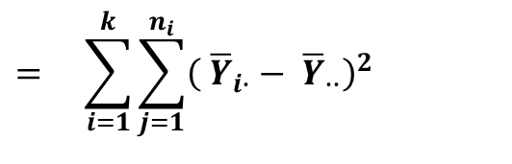
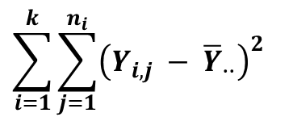
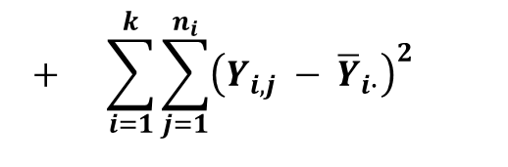
6.5 – Permutation Testing in One Way ANOVA
6.5a – The One-Way ANOVA Model:
With a bit of algebra it can be shown that TSS = SST + SSE *, i.e.
$$\sum_{i=1}^{k}{\sum_{j=1}^{n_{i}}{{\left(Y_{i,j} − {\overline{Y}}_{∙∙}\right)}^{2}}}$$
$$= \sum_{i=1}^{k}{\sum_{j=1}^{n_{i}}{{\left( {\overline{Y}}_{i∙}− {\overline{Y}}_{∙∙}\right)}^{2}}}$$
$$+ \sum_{i=1}^{k}{\sum_{j=1}^{n_{i}}{{\left(Y_{i,j} − {\overline{Y}}_{i∙}\right)}^{2}}}$$
TSS
=
SST
+
SSE
35
*The proof of this statements is not required for this course but is available as supplementary material on the intranet.

Slide 36
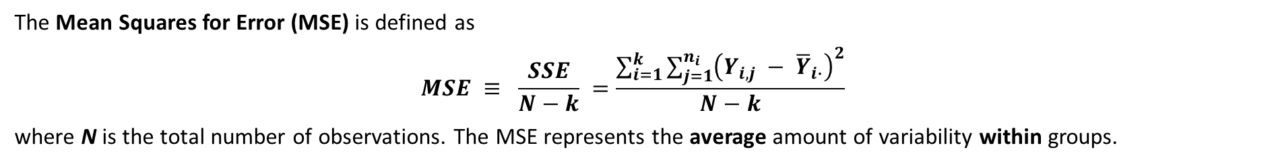
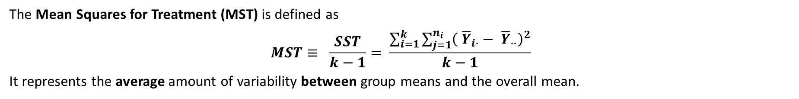

6.5 – Permutation Testing in One Way ANOVA
6.5a – The One-Way ANOVA Model:
The Mean Squares for Treatment (MST) is defined as
$$MST≡ \frac{SST}{k−1}= \frac{\sum_{i=1}^{k}{\sum_{j=1}^{n_{i}}{{\left( {\overline{Y}}_{i∙}− {\overline{Y}}_{∙∙}\right)}^{2}}}}{k−1}$$
It represents the average amount of variability between group means and the overall mean.
The Mean Squares for Error (MSE) is defined as
$$MSE ≡ \frac{SSE}{N−k} =\frac{\sum_{i=1}^{k}{\sum_{j=1}^{n_{i}}{{\left(Y_{i,j} − {\overline{Y}}_{i∙}\right)}^{2}}}}{N−k}$$
where N is the total number of observations. The MSE represents the average amount of variability within groups.
We define the F-statistic for one way ANOVA such that
$$F ≡ \frac{MST}{MSE} = \frac{{SST }/{ \left(k−1\right)}}{{SSE }/{ (N −k)}} = \frac{{\sum_{i=1}^{k}{\sum_{j=1}^{n_{i}}{{\left( {\overline{Y}}_{i∙}− {\overline{Y}}_{∙∙}\right)}^{2} }}}/{ \left(k−1\right)}}{{\sum_{i=1}^{k}{\sum_{j=1}^{n_{i}}{{\left(Y_{i,j} − {\overline{Y}}_{i∙}\right)}^{2} }}}/{ ( N −k )}}$$
36

Slide 37
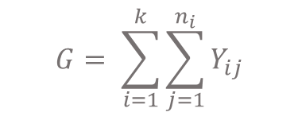
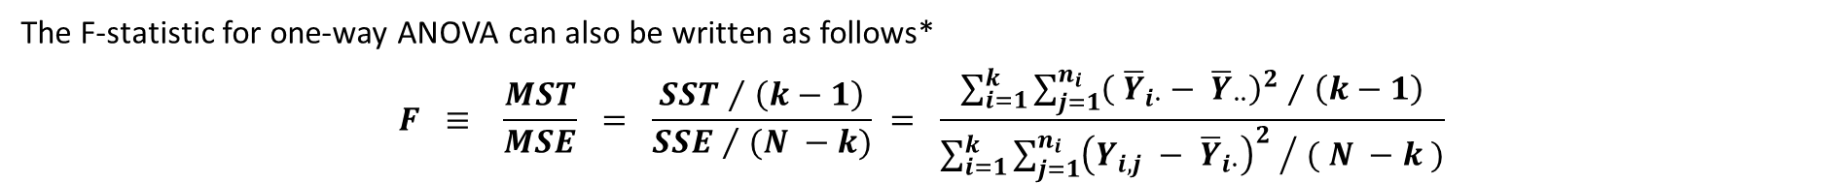
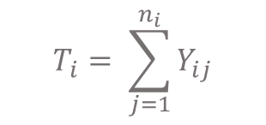
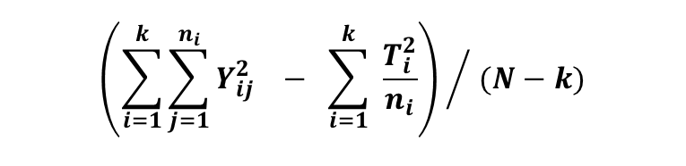
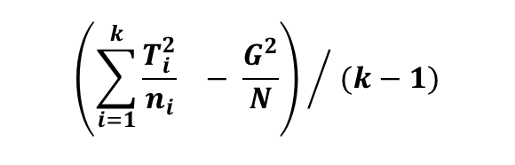
6.5 – Permutation Testing in One Way ANOVA
6.5a – The One-Way ANOVA Model:
The F-statistic for one-way ANOVA can also be written as follows*
$$F ≡ \frac{MST}{MSE} = \frac{{SST }/{ \left(k−1\right)}}{{SSE }/{ (N −k)}} = \frac{{\sum_{i=1}^{k}{\sum_{j=1}^{n_{i}}{{\left( {\overline{Y}}_{i∙}− {\overline{Y}}_{∙∙}\right)}^{2} }}}/{ \left(k−1\right)}}{{\sum_{i=1}^{k}{\sum_{j=1}^{n_{i}}{{\left(Y_{i,j} − {\overline{Y}}_{i∙}\right)}^{2} }}}/{ ( N −k )}}$$
$${\left(\sum_{i=1}^{k}{\frac{T_{i}^{2}}{n_{i}}} − \frac{G^{2}}{N}\right) }/{ (k−1)}$$
where
$$T_{i}= \sum_{j=1}^{n_{i}}{Y_{ij}}$$
$$G= \sum_{i=1}^{k}{\sum_{j=1}^{n_{i}}{Y_{ij}}}$$
=
$${\left(\sum_{i=1}^{k}{\sum_{j=1}^{n_{i}}{Y_{ij}^{2}}} − \sum_{i=1}^{k}{ \frac{T_{i}^{2}}{n_{i}}}\right) }/{ (N−k)}$$
This is how the F-Statistic for one-way ANOVA appears in the Stat 432 Course Notes.
How does the F-statistic help us determine if the means of each group are the same?
37
*The proof of this statements is not required for this course but is available as supplementary material on the intranet.

Slide 38



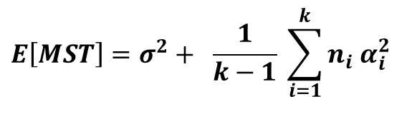
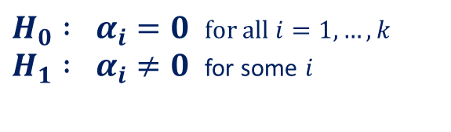
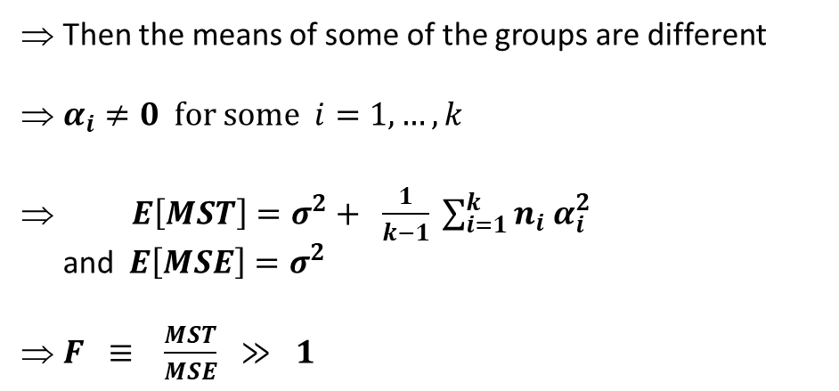
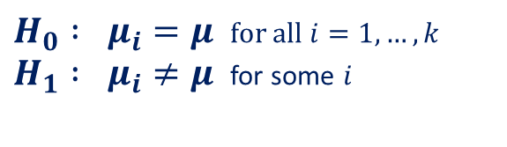
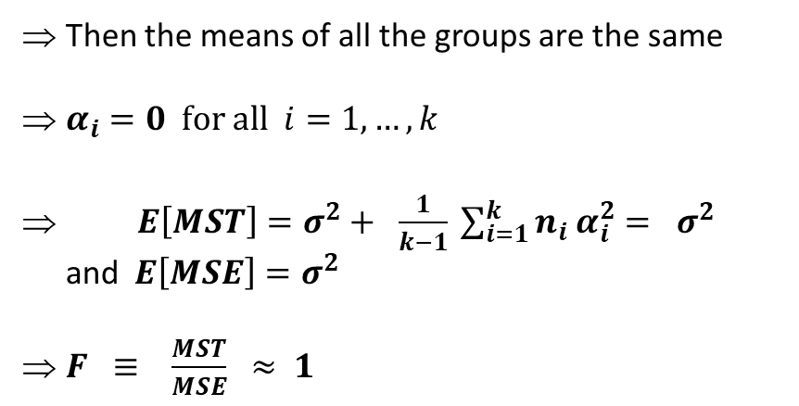


6.5 – Permutation Testing in One Way ANOVA
6.5a – The One-Way ANOVA Model:
It can be shown that*…
$$E\left[MST\right]=σ^{2}+ \frac{1}{k−1} \sum_{i=1}^{k}{{n_{i} α}_{i}^{2}}$$
and
$$E\left[MSE\right]=σ^{2}$$
So consider the F-statistic $F ≡ \frac{MST}{MSE}$
$H_{0} : μ_{i}= μ_{j}$ for all $i,j=1, …, k$ $H_{1} : μ_{i}≠ μ_{j}$ for some $i≠j$
$H_{0} : μ_{i}=μ$ for all $i=1, …, k$ $H_{1} : μ_{i}≠μ$ for some $i$
$H_{0} : α_{i}=0$ for all $i=1, …, k$ $H_{1} : α_{i}≠0$ for some $i$
$$↔$$
$$↔$$
If H₀ is true
If H₁ is true
Then the means of all the groups are the same
$α_{i}=0$ for all $i=1, …, k$
$E\left[MST\right]=σ^{2}+ \frac{1}{k−1} \sum_{i=1}^{k}{{n_{i} α}_{i}^{2}}= σ^{2}$ and $E\left[MSE\right]=σ^{2}$
$F ≡ \frac{MST}{MSE} ≈ 1$
Then the means of some of the groups are different
$α_{i}≠0$ for some $i=1, …, k$
$E\left[MST\right]=σ^{2}+ \frac{1}{k−1} \sum_{i=1}^{k}{{n_{i} α}_{i}^{2}}$ and $E\left[MSE\right]=σ^{2}$
$F ≡ \frac{MST}{MSE} ≫ 1$
38
*The proof of these statements is not required for this course but is available as supplementary material on the intranet.

Slide 39





6.5 – Permutation Testing in One Way ANOVA
6.5a – The One-Way ANOVA Model:
We want to test the hypothesis that the means of all the groups are equal, i.e.
Suppose that we have a total of i = 1, …, k population groups that are…
Independent
Normally distributed
Have equal variance σ²
ANOVA Conditions:
$H_{0} : μ_{i}= μ_{j}$ for all $i,j=1, …, k$ $H_{1} : μ_{i}≠ μ_{j}$ for some $i≠j$
To test between H₀ and H₁ we calculate the F-statistic for one-way ANOVA:
$$F ≡ \frac{MST}{MSE} = \frac{{SST }/{ \left(k−1\right)}}{{SSE }/{ (N−k)}}$$
If the ANOVA conditions are satisfied
$$F \sim F_{k−1, N −k}$$
We look to see where F_{obs} lies in the distribution of F _{k-1 , N-k}
The bigger the value of F_{obs} the smaller the p-value
$$P\left( F≥F_{obs} \right)$$
of the test and the more evidence we have against H_{0.}
$$F_{obs}$$
$$P(F≥F_{obs})$$
39

Slide 40
6.5 – Permutation Testing in One Way ANOVA
6.5a – The One-Way ANOVA Model:
We want to test the hypothesis that the means of all the groups are equal, i.e.
Suppose that we have a total of i = 1, …, k population groups that are…
Independent
Normally distributed
Have equal variance σ²
ANOVA Conditions:
$H_{0} : μ_{i}= μ_{j}$ for all $i,j=1, …, k$ $H_{1} : μ_{i}≠ μ_{j}$ for some $i≠j$
To test between H₀ and H₁ we calculate the F-statistic for one-way ANOVA:
$$F ≡ \frac{MST}{MSE} = \frac{{SST }/{ \left(k−1\right)}}{{SSE }/{ (N−k)}}$$
If the ANOVA conditions are not satisfied
then although we can still calculate the F-statistic, this will no longer follow an F_{k-1 , N-k} distribution.
=> the p-value produced from ANOVA will be meaningless => We won’t be able to use the p-value to decide between the null and alternative hypothesis.
Q: How do we decide between H₀ and H₁ if the ANOVA conditions are violated?
A: We do a permutation test
40

Slide 41
6.5b – Transport Study Example:
6.5 – Permutation Testing in One Way ANOVA
As part of a transport study, data were collected on travel times from a certain suburb to the city centre during the morning rush hour. Three methods are to be compared, bus, private car and bicycle.
 | Time in Mins
Bus | 21 | 23 | 27 | 22 | 31
Car | 23 | 28 | 22 | 25
Cycle | 29 | 27 | 30 | 29
Does the mean travel time differ by mode of transport?
H₀: Mean travel time is the same across all transport modes
H₁: Mean travel time differs across some transport modes
41
Associated code = 6.5 – Transport Study Example (One Way ANOVA).

Slide 42


6.5b – Transport Study Example:
6.5 – Permutation Testing in One Way ANOVA
Normal theory ANOVA yields:
F-Statistic = 2.452, df = (2,10), p-value = 0.136
=> No evidence against the null hypothesis.
However, because sample size is small, no way to conclusively tell if ANOVA conditions are satisfied.
Quick inspection suggests that ANOVA conditions likely to be violated.
Box-plot suggests non-constant variance across transport modes
QQ-plot suggests travel time not normally distributed
Must conduct permutation test
42
Associated code = 6.5 – Transport Study Example (One Way ANOVA).

Slide 43


6.5b – Transport Study Example:
6.5 – Permutation Testing in One Way ANOVA
Histogram of F-Statistics Produced from 1,000 Reordered Samples
F_{obs} = 2.452
F_{Obs} lies in the 86.3rd percentile of F-statistic produced from 1,000 reordered samples.
$$P\left( F≥F_{obs} \right)≈0.137$$
Permutation test yields no evidence against null hypothesis that travel time is the same across all modes
Approx 1.72 seconds to run
43
Associated code = 6.5 – Transport Study Example (One Way ANOVA).

Slide 44



6.5b – Transport Study Example:
6.5 – Permutation Testing in One Way ANOVA
In the previous example, we used the usual ANOVA F-statistic
where
$$F = \frac{{\left(\sum_{i=1}^{k}{\frac{T_{i}^{2}}{n_{i}}} − \frac{G^{2}}{N}\right) }/{ (k−1)}}{{\left( \sum_{i=1}^{k}{\sum_{j=1}^{n_{i}}{Y_{ij}^{2}} − \sum_{i=1}^{k}{\frac{T_{i}^{2}}{n_{i}}}} \right) }/{ (N−k)}}$$
$$T_{i}= \sum_{j=1}^{n_{i}}{Y_{ij}}$$
$$G= \sum_{i=1}^{k}{\sum_{j=1}^{n_{i}}{Y_{ij}}}$$
Can we find an equivalent test statistic that is computationally simpler?
The terms $A≡ \frac{G^{2}}{N}$ and $B≡\sum_{i=1}^{k}{\sum_{j=1}^{n_{i}}{Y_{ij}^{2}}}$ are constants, they won’t change when the data are permuted.
Only the term $X≡\sum_{i=1}^{k}{\frac{T_{i}^{2}}{n_{i}}}$ will change when the data are permuted. So, let’s re-write F as:
$$F= \frac{N−k}{k−1}⋅ \frac{X −A}{B −X}$$
$$\frac{dF}{dX} = \frac{N −k}{k −1}⋅ \frac{B −A}{{\left(B −X\right)}^{2}} ≥ 0$$
Use quotient rule
Note B ≥ A can be proven algebraically
44

Slide 45



6.5b – Transport Study Example:
6.5 – Permutation Testing in One Way ANOVA
$$T_{i}= \sum_{j=1}^{n_{i}}{Y_{ij}}$$
F is a monotone increasing function of $X≡\sum_{i=1}^{k}{\frac{T_{i}^{2}}{n_{i}}}$.
This implies that that F and X are equivalent.
Their application to any set of re-ordered samples will endow those samples with the same ordering.
where
If the F statistic for sample S1 is greater than the F statistic for sample S2
⬄ the X statistic for sample S1 is greater than the X statistic for sample S2
Since $X≡\sum_{i=1}^{k}{\frac{T_{i}^{2}}{n_{i}}}$ is computationally simpler than $F =\frac{{\left(\sum_{i=1}^{k}{\frac{T_{i}^{2}}{n_{i}}} − \frac{G^{2}}{N}\right) }/{ (k−1)}}{{\left( \sum_{i=1}^{k}{\sum_{j=1}^{n_{i}}{Y_{ij}^{2}} − \sum_{i=1}^{k}{\frac{T_{i}^{2}}{n_{i}}}} \right) }/{ (N−k)}}$
the former should be preferred as a permutation test statistic as it will speed up the algorithm.
45

Slide 46


6.5b – Transport Study Example:
6.5 – Permutation Testing in One Way ANOVA
Histogram of F-Statistics Produced from 1,000 Reordered Samples
Using New Test Statistic
X_{obs} = 8782.45
X_{Obs} lies in the 87.4th percentile of test statistics produced from 1,000 reordered samples.
$$P\left( X≥X_{obs} \right)≈0.126$$
Permutation test yields no evidence against null hypothesis that travel time is the same across all modes
Approx 0.089 seconds to run. Much Faster!
46
Associated code = 6.5 – Transport Study Example (One Way ANOVA).

